Slide 1
Books by and for Customs HI&AI
Enrika Naujoke
World Customs Law Meeting, Berlin, Germany, 2023

Slide 2
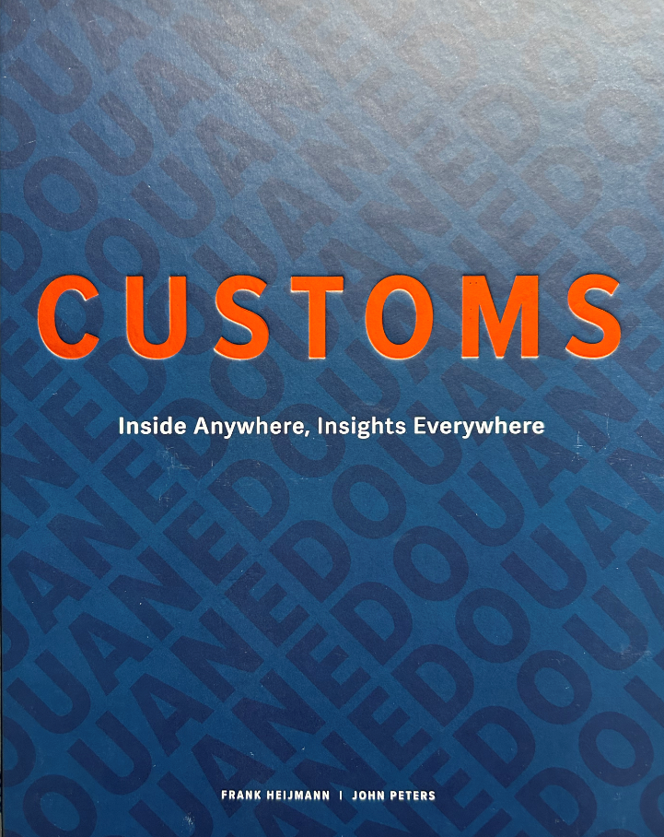
2039, the Netherlands, newsbots inform:
“Customs is being abolished next January (2040) when the EU’s new customs system [Artificial Customs Intelligence Depository, ACID] comes into operation …”
Introduction to the book “Customs Inside Anywhere, Insights Everywhere” by Frank Heijmann and John Peters

Slide 3
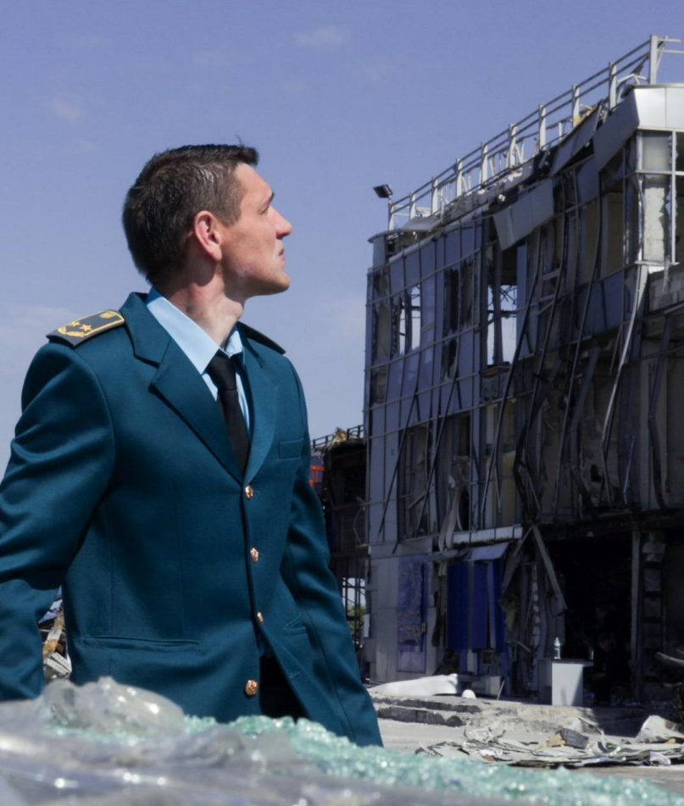
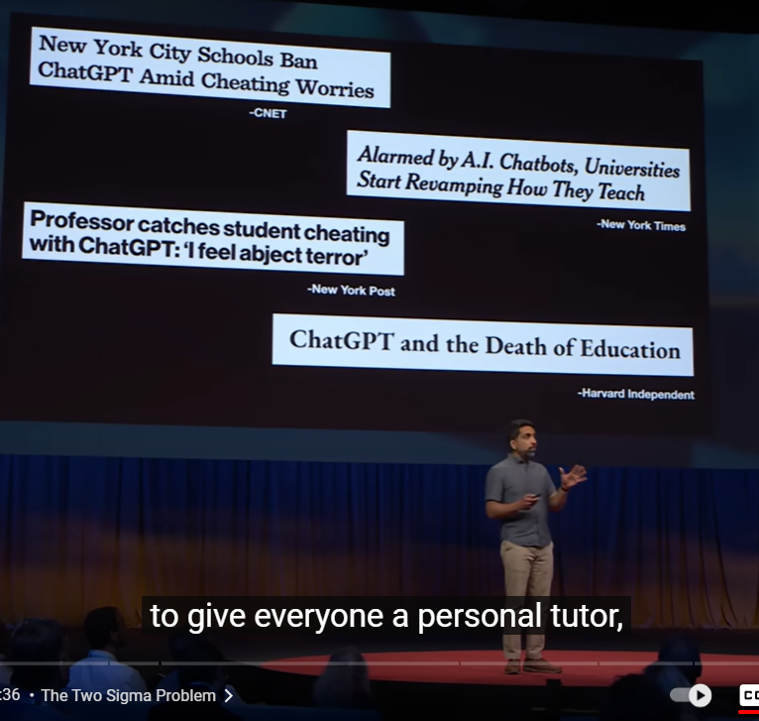
smart, fast, global and workable solutions are urgently needed
Photo: Ukraine, WCO Photo Competition 2022
Photo: Adobe Stock
www.youtube.com/watch?v=hJP5GqnTrNo

Slide 4
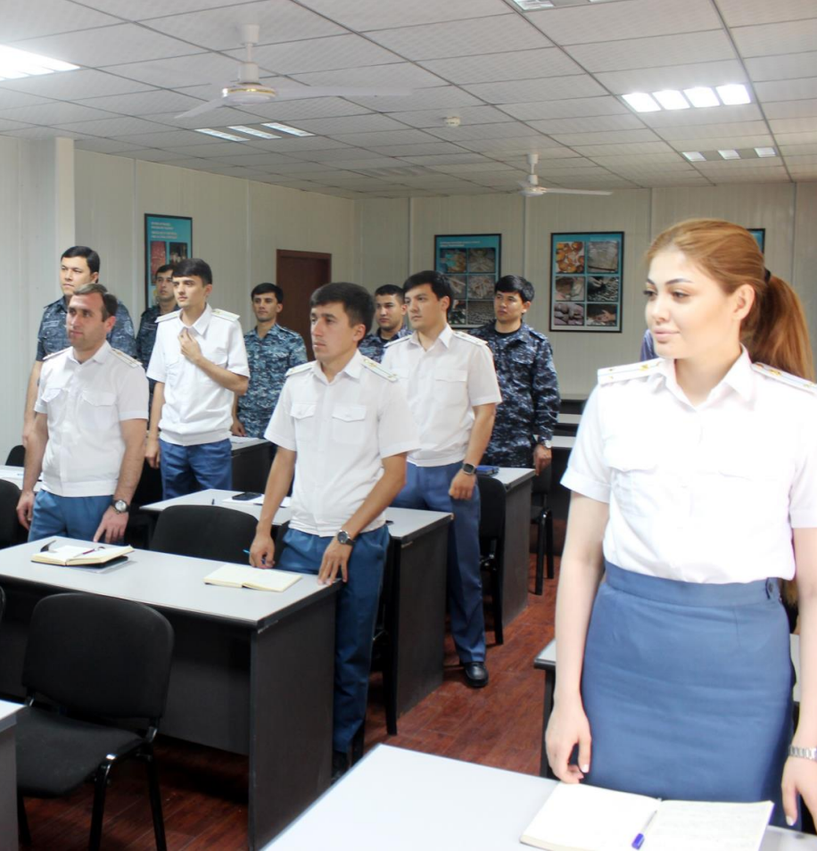
WCO Theme 2023
CUSTOMS HI
the need
for more and
better skilled staff
Photo: Tajikistan, WCO Photo Competition 2023

Slide 5
90%
legal rules
are numerous
and ever-changing
Photo: Adobe Stock

Slide 6
Read a book?
There's a summary online!
Source of knowledge?
Internet, of course!
Photo: Adobe Stock

Slide 7
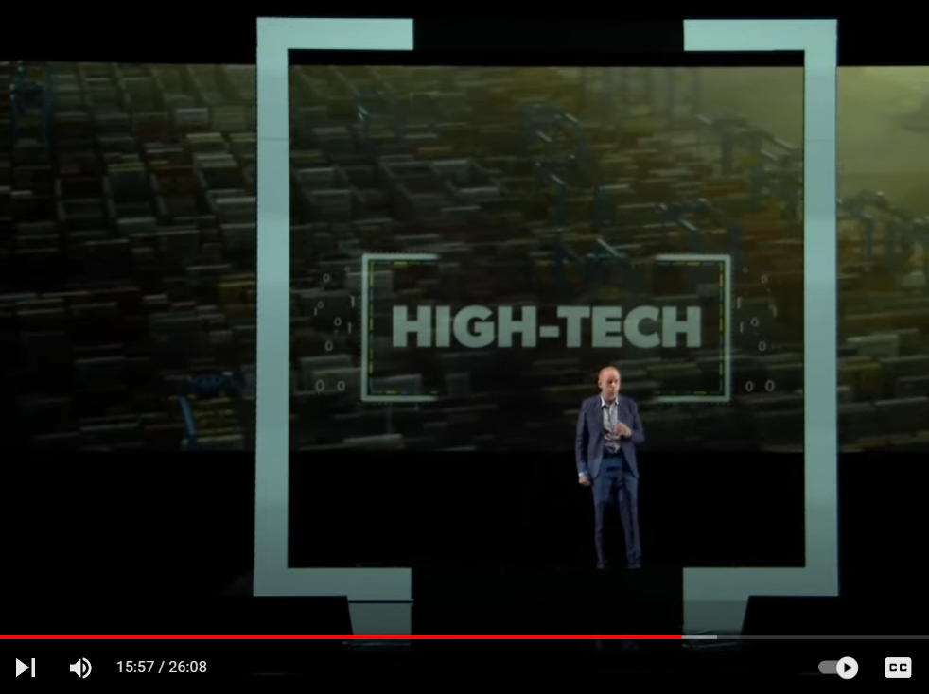
The better we become at this [high-tech], the more efficient our enforcement becomes.
https://www.youtube.com/watch?v=iANqS243eH0

Slide 8
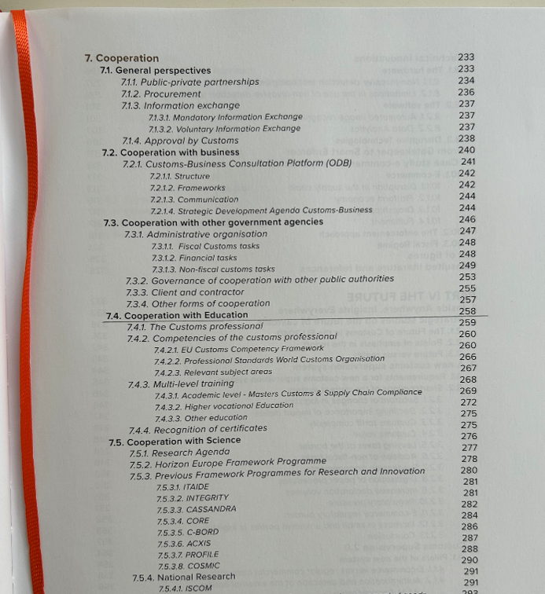
Non-AI
Need for professionals with multidisciplinary training
Joint training of customs and business professionals
The level of training … has been a stumbling block

Slide 9
Let's let AI do the list of the latest books on customs for us!
Photo: Adobe Stock

Slide 10
Doesn’t know (information only until 2021).”
ChatGPT
Customs and Trade Compliance: A Comprehensive Guide by Mark K. Neville, Jr. (2023), etc.
Bard
Bard

Slide 11
Library in Prague, Czech Republic
Photo: Adobe Stock

Slide 12
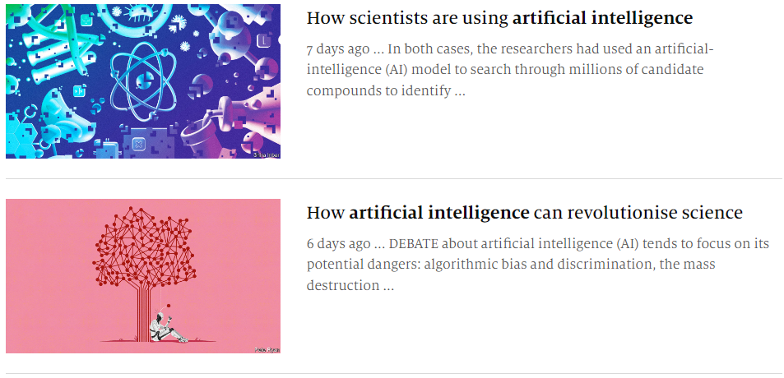
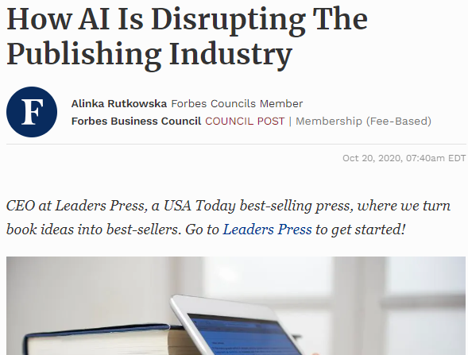
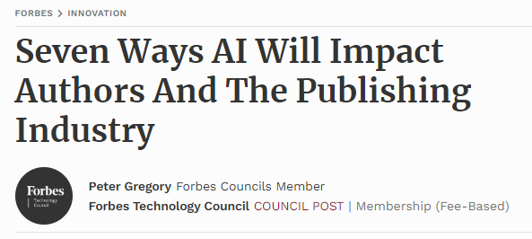
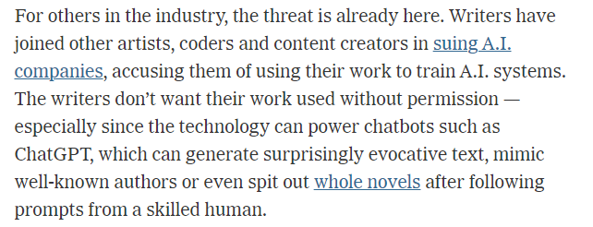

Slide 14
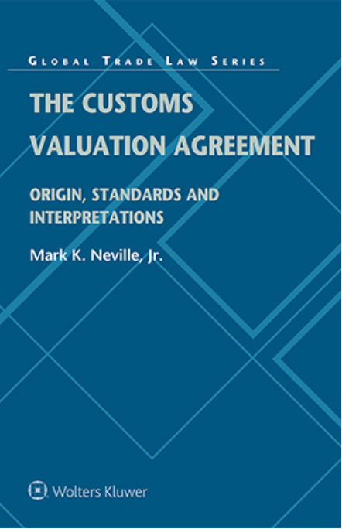
Global Webinar: Books on Customs 2022

Slide 15
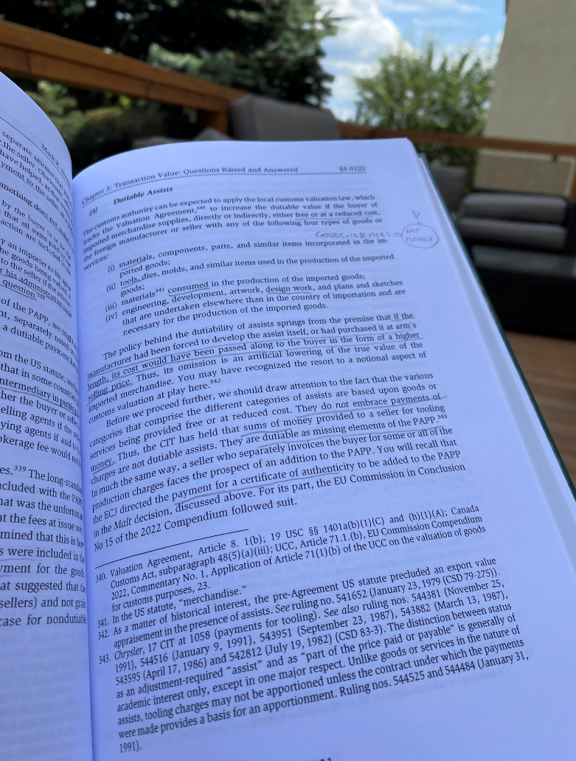
Mark:
“… The book is intended to show what led to the 1979 and 1994 adoptions of the Customs Valuation Agreement and also to both expose and explain the real challenges that confront us.“
Monika:
“It is such a concentration of wisdom on customs valuation that you want to take the time to digest it.
Mark does not shy away from strong wording and I often have to smile when I read it (e.g. "too-clever-by-half view", "some practices <..> are zombie-like in their refusal to pass away").”
Photo by Monika Bielskiene

Slide 16
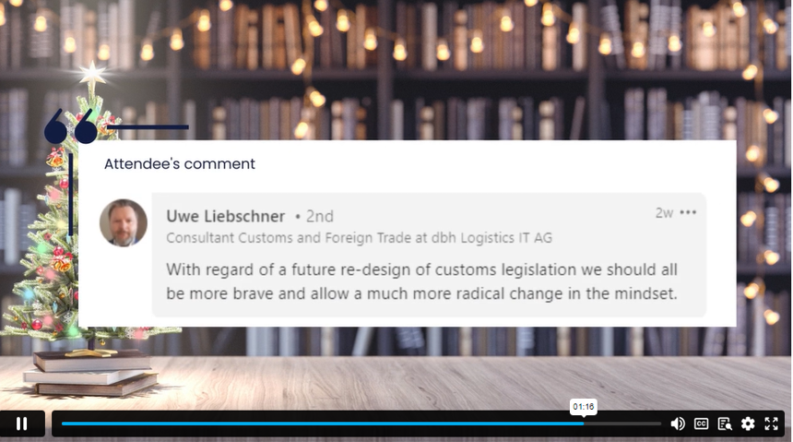
What about the books and their re-design?

Slide 17
Synergy of HI&AI

Slide 18
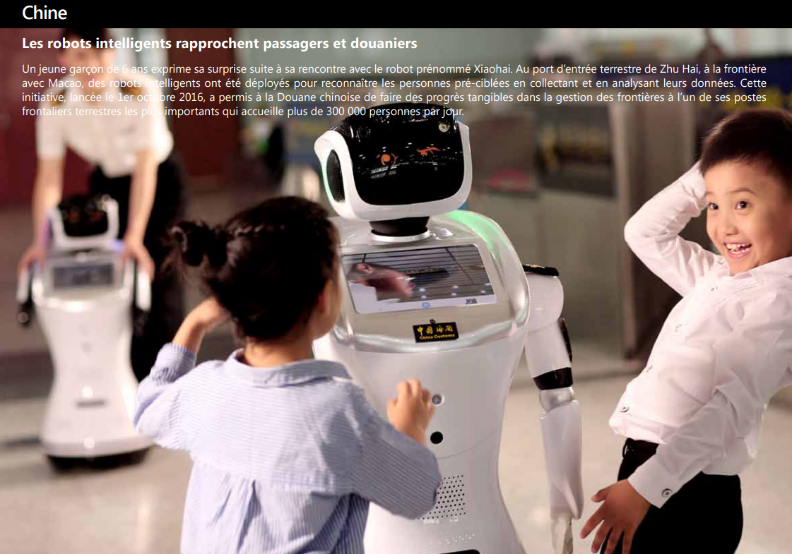
because Customs play an important role on our one of a kind planet
Photo: China, WCO Photo Competition

Slide 19
What do you think?
AI DALL·E
enrika@customsclear.net

