Slide 1
Diversification of EU Trade Relations with regard to the Americas: A German Perspective on Resilient and Sustainable Trade Relations Christian Forwick Deputy Director General External Economic Relations, Trade Policy, Policy, America

Slide 2
State of Play
◘ CETA: Ratification November 2022
◘ Chile: December 2022 - Political closure of the modernization of the Association Agreement (effective since 2003)
◘ Kenia: Political conclusion June 2023 (for an EPA)
◘ New Zealand: FTA signed July 2023
◘ MERCOSUR, Mexico, Australia: Finalizing of negotiations in 2023
◘ Indonesia, India: Negotiations ongoing
◘ Thailand, Philippines, Malaysia: Relaunch of negotiations (planned)

Slide 3
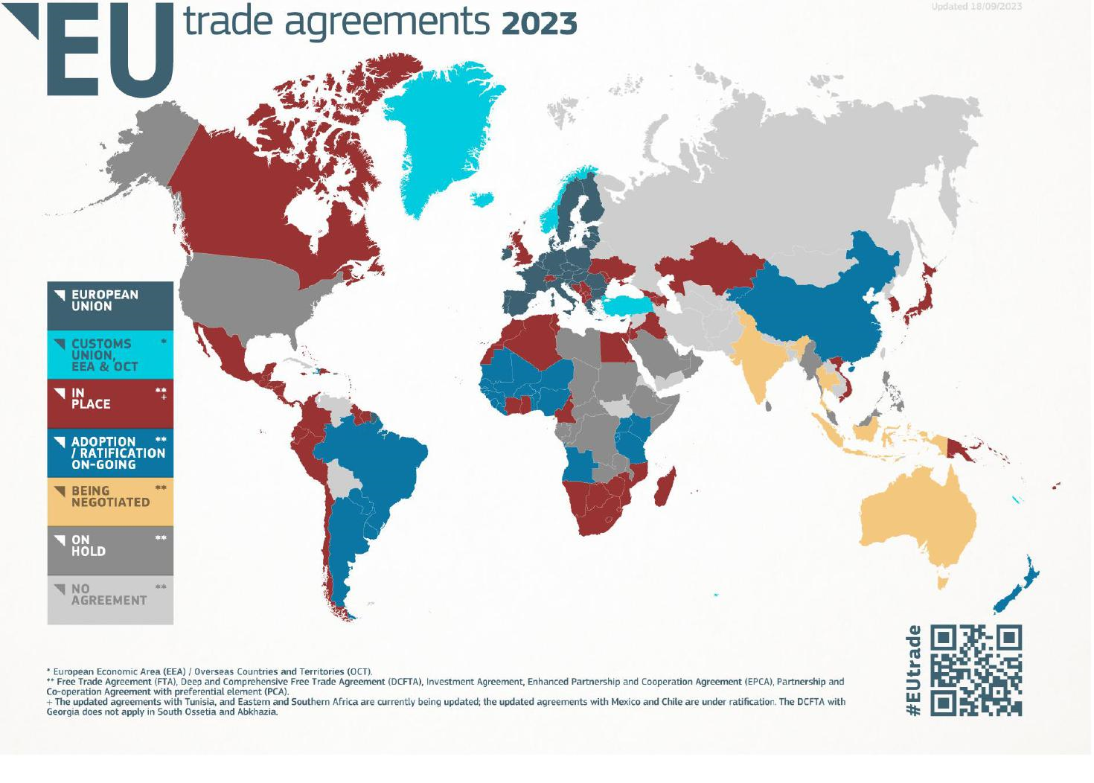

Slide 4
Focus on Central and Latin America Mercosur (ARG, BRA, PRY, URY) Chile Mexico USMCA

Slide 5
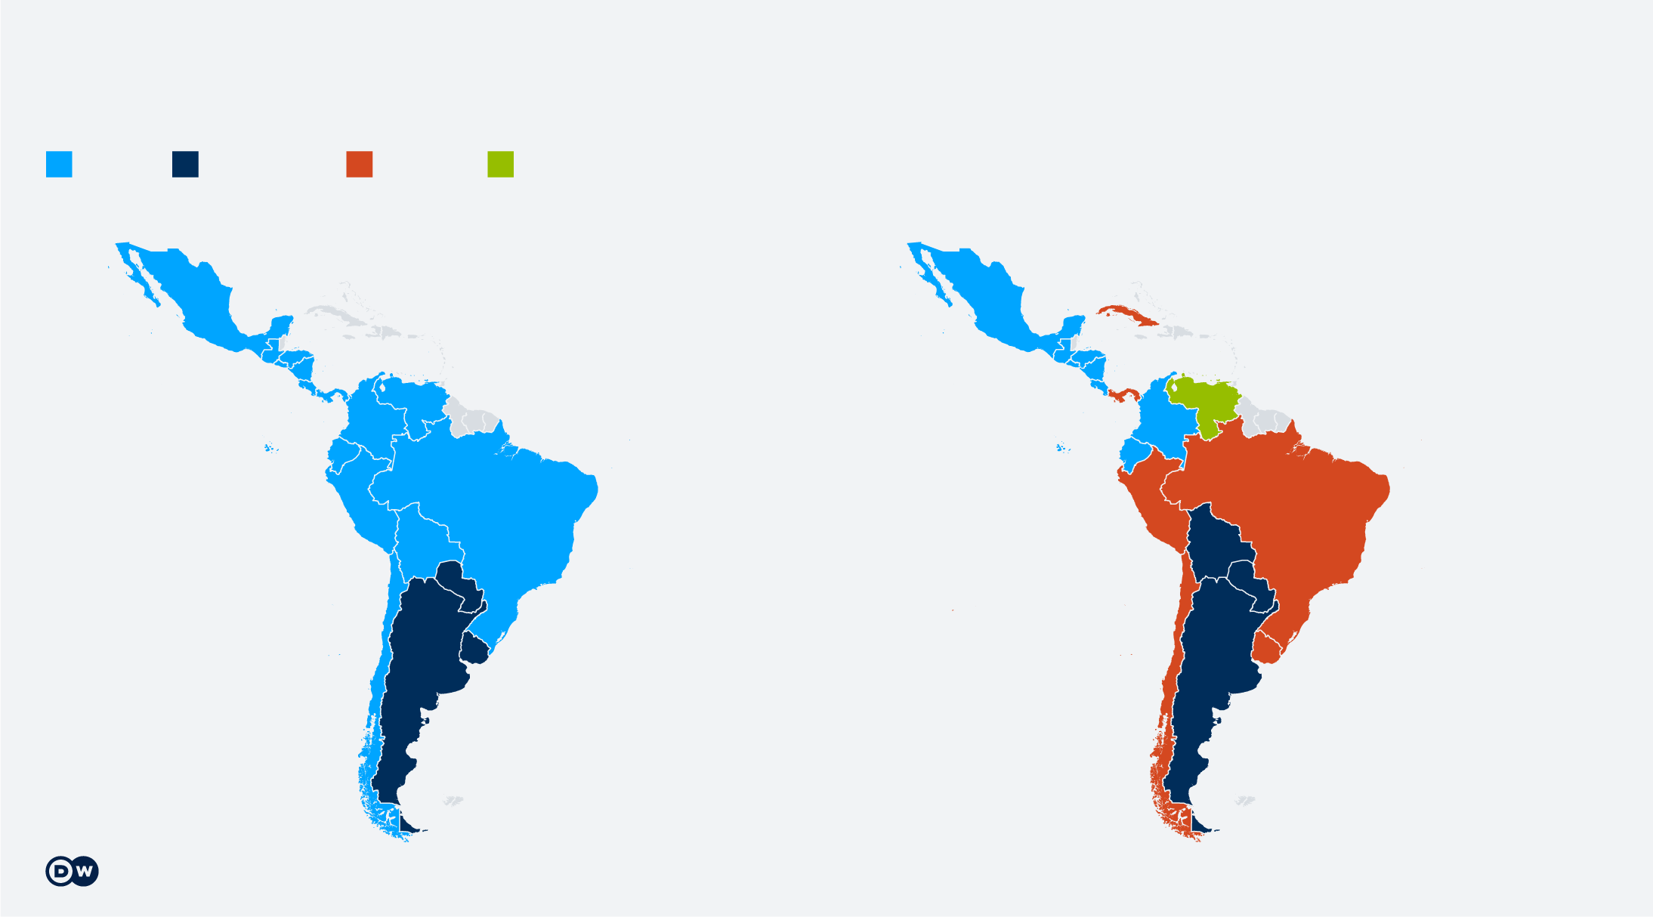
China in Central and Latin America
CHN most important trading partner (BRA, ARG, CHL, URS, PER, PAN)
CHN has FTAs with CHL, CRI, PER (URY, ELS, PAN negotiations)
CHN is main investor: strategic - raw materials (infrastructure, Oil, Gas)
USA BRA CHN IND
2000
2022

Slide 6
China – Belt and Road Partner
Antigua und Barbuda, Argentina, Barbados, Bolivia, Chile, Costa Rica, Dominica, Dominikanische Republik, Ecuador, El Salvador, Grenada, Guyana, Jamaica, Kuba, Nicaragua, Panama, Peru, Suriname, Trinidad und Tobago, Uruguay, Venezuela

Slide 7
EU - MERCOSUR
June 2019: Political agreement for a trade agreement
March 2023: EU-Proposal for an „Additional Instrument“
September 2023: MERCOSUR Reply
Timely finalization of the agreement

Slide 8
Market Access EU – MERCOSUR
Reduction of tariffs for German exporters and importers
Gradual liberalisation of tariffs on 91% of all goods
Huge potential with view to current MERCOSUR tariffs such as:
Cars: 35% (DE exports to MERCOSUR 2,2 billion EUR, including car parts)
Car parts: 14-18%
Machinery: 14-20% (DE exports to MERCOSUR 5 billion EUR)
Chemicals: up to 18% (DE exports to MERCOSUR 4 billion EUR)
Clothing: 35%
Pharmaceuticals: up to 14% (DE exports to MERCOSUR 1 billion EUR)
Leather shoes: 35%

Slide 9
EU – MERCOSUR – Other Benefits
Modern regulatory framework stable and predictable rules for trade and investment
IP rights, digitalization, food safety, competition, procurement simplification of customs procedures, technical regulations and standards
Sustainable trade

Slide 10
EU – Chile
Chile Latin America’s fifth-largest economy
EU-Chile trade in goods grew by 163% between 2002 and 2021
EU goods exports to Chile grew by 284% in the same period
99.9% of EU exports will be tariff-free = further increase of EU exports to Chile by up to EUR 4.5 billion.
Cooperation on raw materials and clean fuel crucial for the transition to the green economy, such as lithium, copper, and hydrogen
Easier for German and EU companies to provide their services in Chile
Strong Sustainability Chapter – (Review Clause)

Slide 11
EU – Mexico
EU-MEX “Global Agreement” since 2000
Negotiations for new EU-MEX agreement (2020) but ongoing
Germany committed to swiftly finalize modernization
New agreement = new business opportunities for both parties (e.g. reciprocal access to public procurement, liberalization of trade in agricultural goods), strong and clear commitments on human rights, sustainable development and the fight against corruption
High potential: MEX emerging economy of 129 million and EU market with 448 million people

Slide 12
USMCA – US – Mexico- CAN Agreement
Entry into force 1 July 2020 - Substitutes NAFTA (1994)
Stronger RuoO (62,5 up to 75% USMCA origin)
Minimum wage 16 USD
Protection of IP
Workers rights
Dispute settlement – 3 mechanisms
SME chapter
German Experience

Slide 13
Thank you for your attention

